Slide 1
Template
Moritz Flüchter

Slide 2
TEXT ONLY
HEADING
TEXT

Slide 3
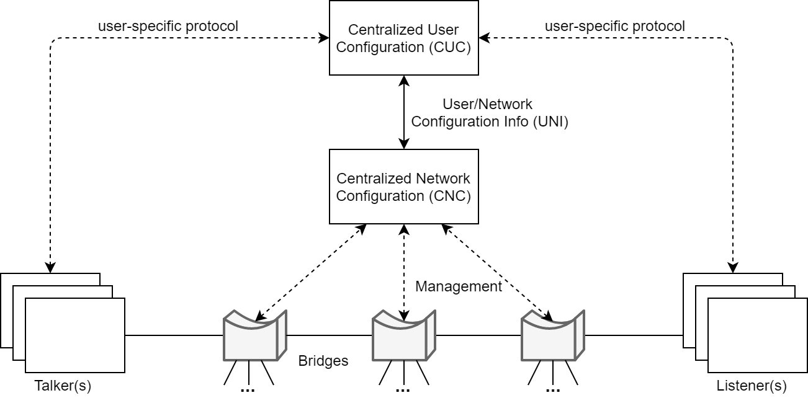
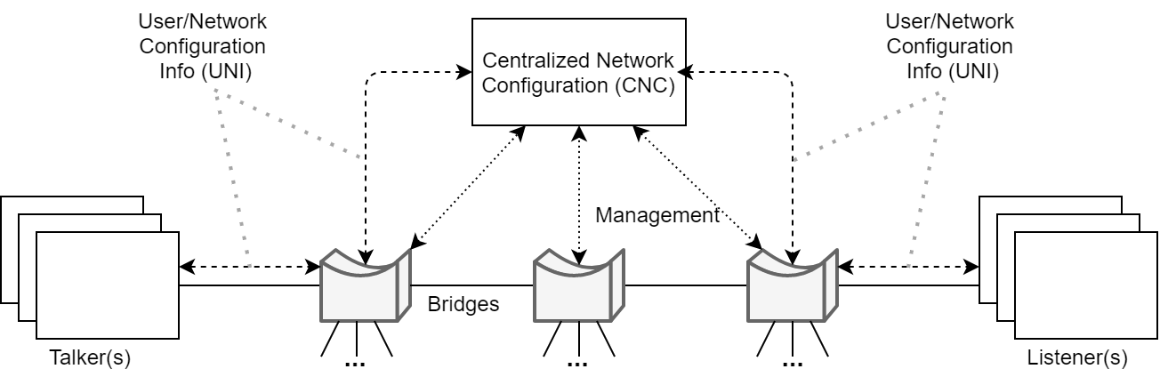
COMPARISON/2 TOPICS
HEADING 1
HEADING 2
TEXT
TEXT

Slide 4
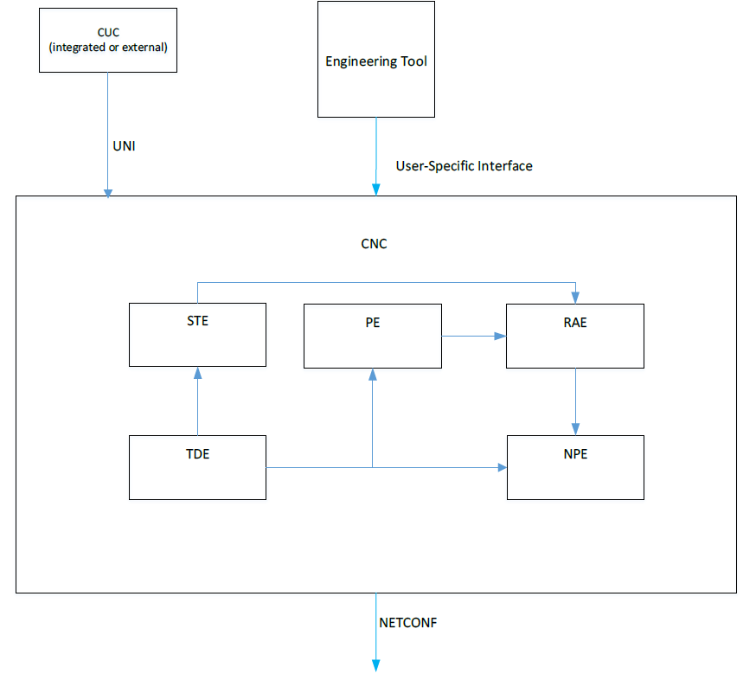
TEXT + IMAGE
HEADING
TEXT

Slide 5
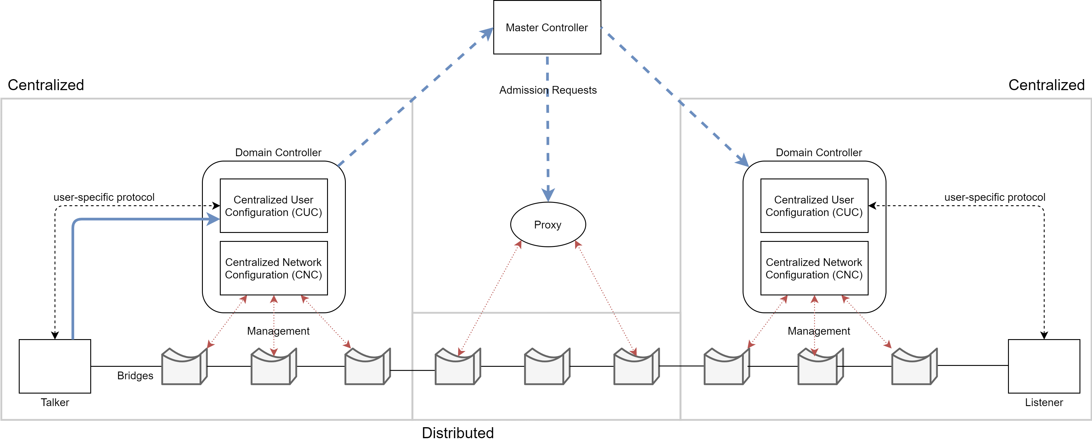
TEXT BELOW IMAGE
HEADING
TEXT

